Slide 1
Song Genre Classification
Daniel Dias
Wyndham Hudson
Phalguna Rupanagudi
Sukris Vong
Brett Watanabe

Slide 2

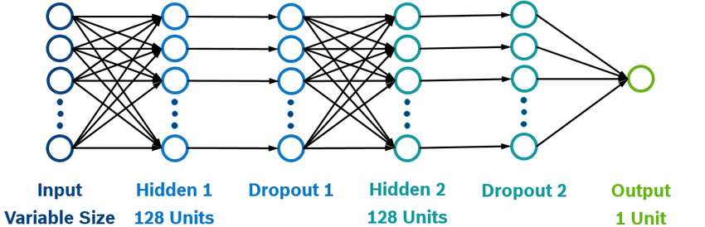
What is this song’s genre?
Pop?
Reggae?
Rock?

Slide 3



Why?
Music Recommendation
Music Generation
Notes:
Anecdotal

Slide 4
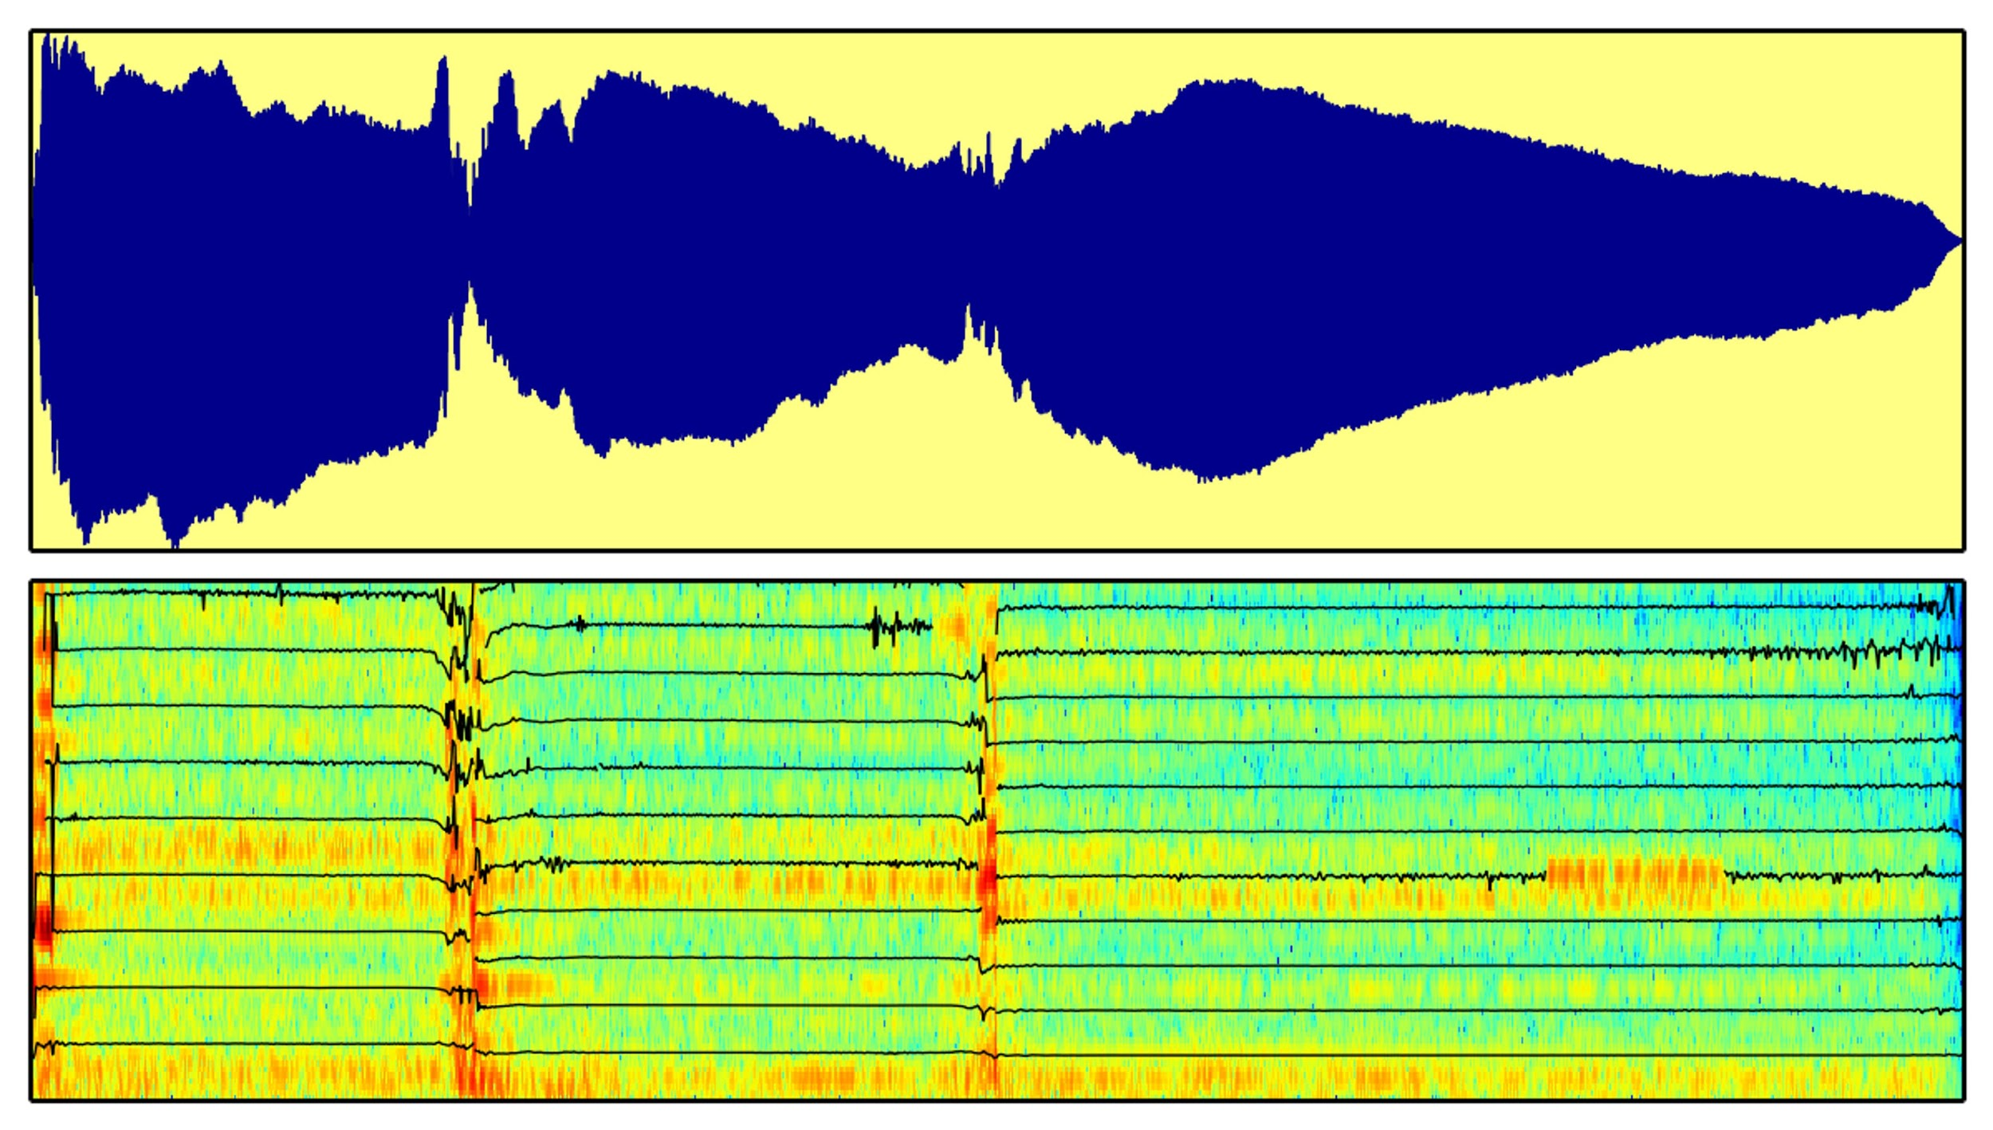
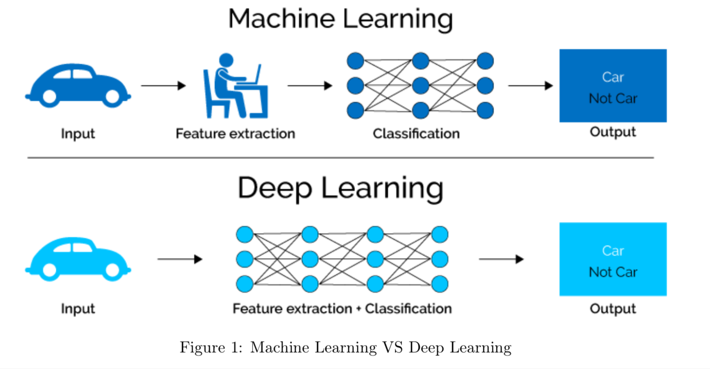
A Brief History
1990s - 2000s
2010s
Signal Processing
Machine Learning and Deep Learning
Notes:
Early audio classification research focused on using feature extraction and signal processing.

Slide 5
A little about audio files
Structure
Array of samples (e.g. [ 0.00732422, 0.01660156, …, -0.05560303 ] )
Sample Rate = number of samples per second (Hertz)
Audio files are large!
If the sample rate is 22150 and the song is 30s long, there are 664,500 samples
A modern song is typically 3-5 minutes long (~ 5 million samples)
Notes:
Microphones record audio files as magnitudes over time. Humans hear pitches as frequencies, not magnitudes. All audio models we tried turns magnitudes into frequencies.
Sample rate = number of magnitudes/data points a second
Higher sample rate leads to higher quality audio file
So if song is 30s, there are sample rate * 30s
All training songs are 30s clips

Slide 6
Metadata Model

Slide 7
Inspiration
Artist Name
Lil Pump
Slayer
Lil Peep
Bloody Hammer
Catfish and the Bottlemen
Death of Kings
Tom Petty and the Heartbreakers
Lil Wayne
Blood Incantation
Lil Nas X
Song Title
Symphony No. 40 Molto allegro
Momma Told Me ft. J.I.D
Cello Concerto No. 1 Moderato
Sunday ft. Frank Ocean
Piano Sonata No. 11 Turkish March
Plain Jane ft. Nicki Minaj

Slide 8
Inspiration
Artist Name
Lil Pump
Bloody Hammer
Catfish and the Bottlemen
Lil Peep
Lil Nas X
Blood Incantation
Slayer
Lil Wayne
Tom Petty and the Heartbreakers
Death of Kings
Hip Hop
Rock
Metal
Song Title
Symphony No. 40 Molto allegro
Sunday ft. Frank Ocean
Piano Sonata No. 11 Turkish March
Plain Jane ft. Nicki Minaj
Cello Concerto No. 1 Moderato
Momma Told Me ft. J.I.D
Classical
Hip Hop

Slide 9
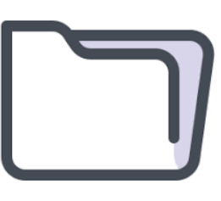
Data
Million Songs Genre Dataset
Jazz and Blues
Metal
Classic Pop and Rock
Reggae
Dance and Electronica
Classical
Folk
Hip Hop
Pop
Training Data
GZTAN Dataset
Blues
Jazz
Metal
Rock
Reggae
Disco
Classical
Country
Hip Hop
Pop
Song Identification API
Testing Data
Notes:
Unbalanced Data (434 Hip Hop Songs vs 23895 Classic Pop and Rock
Repeating artists with different songs
Genres labeled by users

Slide 10
Implementation 1: Naïve Bayes
Metadata Elements
Artist Name
Song Title
Album Name
Year
Album Cover
Bag of Words
Artist Name
Song Title
(0, 10298) 1
(0, 12338) 1
(0, 17011) 1
(0, 17739) 1
Irma Thomas
(0, 1550) 1
(0, 3189) 1
Sweet Touch Of Love
Naïve Bayes
Used typically in Text Classification
sklearn library “MultinomialNB” implementation

Slide 11
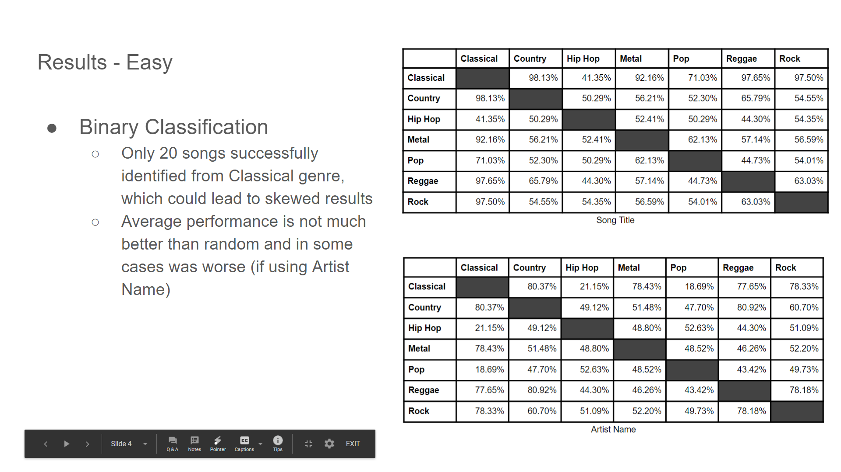
Results - Easy Dataset
Binary Classification
Mixed Results
Song Title outperformed Artist Name
Shortcomings
Unbalanced Training Dataset
434 Hip-Hop vs 23985 Rock
Unbalanced Testing Dataset
20 Classical Songs vs 100 Metal Songs

Slide 12
Results - Hard Dataset
Three Genre Classification
Highest Accuracy (Reggae, Classical, Country):
73.3% - Artist Name
68.6% - Song Title
Lowest Accuracy (Rock, Country, Metal):
42% - Artist Name
39.8% - Song Title
Seven Genre Classification
Metal, Classical, Rock, Pop, Reggae, Country, Hip-hop
27% - Artist Name
23.8% - Song TItle

Slide 13
Implementation 2: KNN
Metadata Elements
Tempo Time Signature Loudness Key Duration
K-Nearest Neighbors
Million Song Dataset (MSD) now balanced (434 of each genre)
80% Training, 20% Testing of MSD
Now uses 9 genres (didn’t have these metadata elements for the GZTAN dataset)
sklearn library “NearestNeighbors” implementation

Slide 14
KNN Results
Binary Genre Classification
Highest Accuracy (Hip-Hop v. Classical):
93.68%
Best Features: time signature, loudness
Lowest Accuracy (Country v. Rock):
63.79%
Best Features: time signature, loudness
Nine Genre Classification
Metal, Classical, Classic Pop and Rock, Pop, Reggae, Folk, Hiphop, Dance and Electronica, Jazz and Blues
29.92%
Best Features: tempo, loudness, key

Slide 15
Audio Analysis

Slide 16
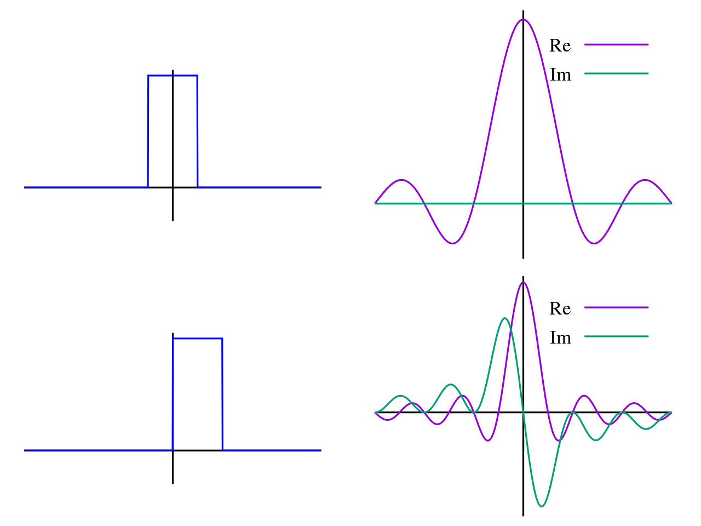
Data Transformation
Fourier Transform

Slide 17
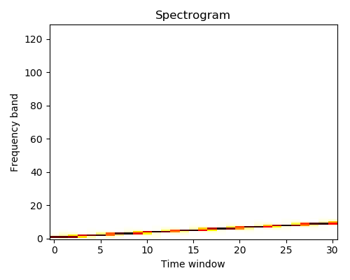
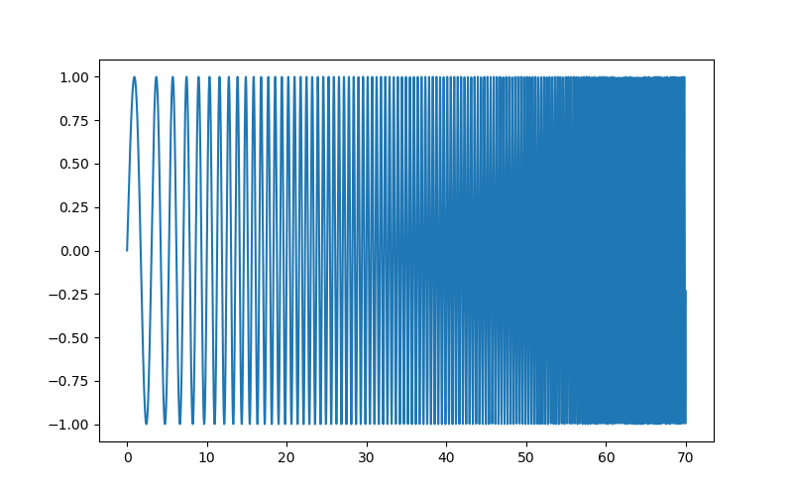
Data Transformation (cont’d)
Source Wave

Slide 18
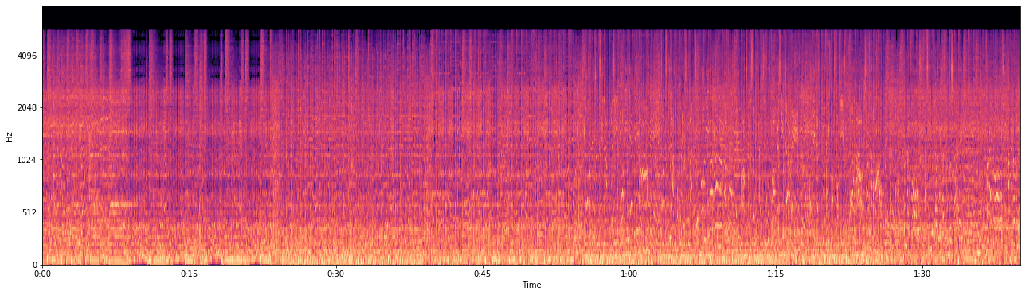
Data Transformation (cont’d)
Example: Symphony X, “Smoke and Mirrors”, first 100 seconds

Slide 19
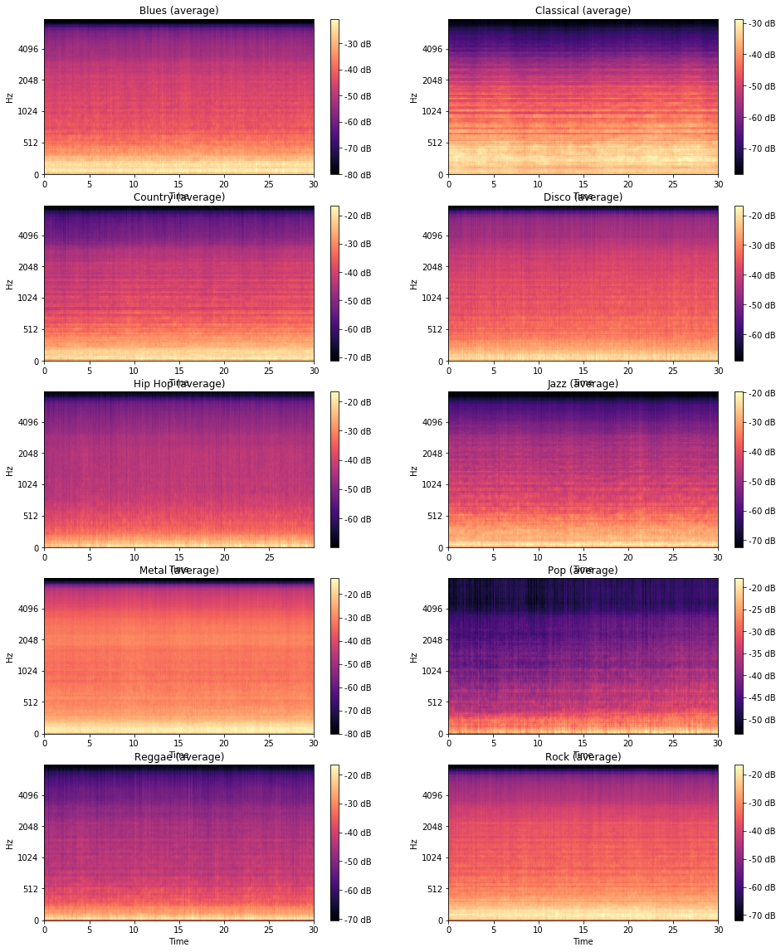
Data
Blues
Classical
Country
Disco
Hiphop
Jazz
Metal
Pop
Reggae
Rock

Slide 20
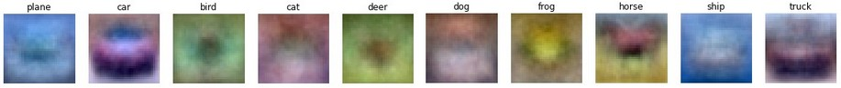
Image Classification Analog

Slide 21
LSTM Model

Slide 22
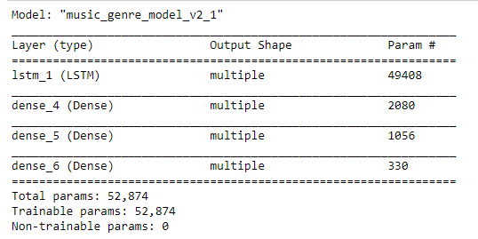
Model Layout
LSTM Layer
Dense
Results:
Average Accuracy: ~30%
on 10 classes
Dense
Dense

Slide 23
Final Model Segmentation Model

Slide 24

Segmentation Model: Pre-Processing
Raw
Audio
Input raw audio file

Slide 25
Segmentation Model: Pre-Processing
Raw
Audio
0.2 seconds
Segment raw audio file into equal widths of 0.2 seconds

Slide 26
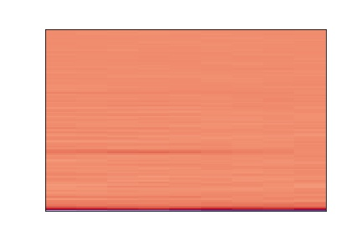
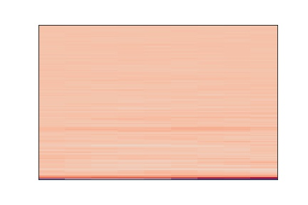
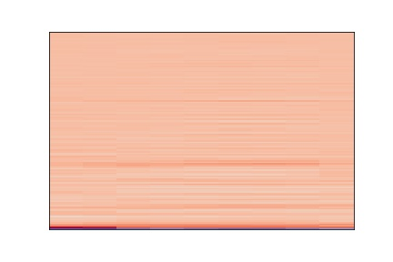
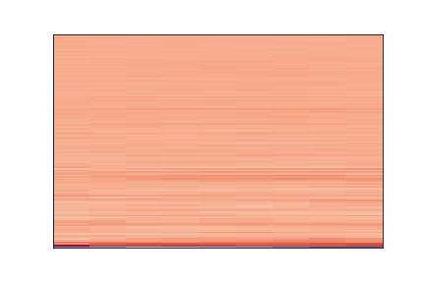
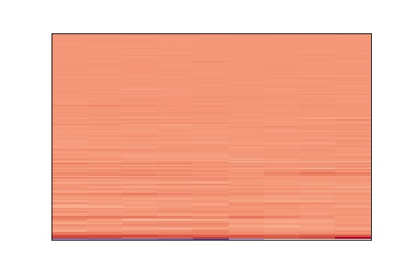
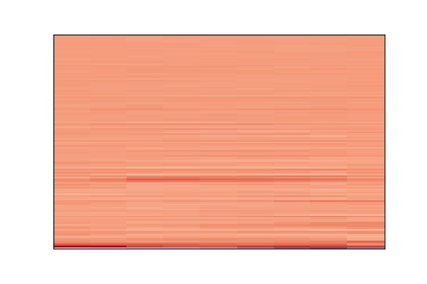
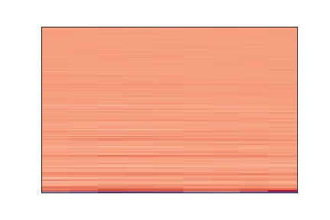
Segmentation Model: Pre-Processing
MFCC Spectrum
Get the Mel Frequency Cepstral Coefficients of each segment

Slide 27
Segmentation Model: Training
MFCC Spectrum
TensorFlow
Neural Network
Train the neural network on each segment
Notes:
Balanced Data
800 songs training, 200 test
5 fully-connected layers
4 dropout layers

Slide 28
Segmentation Model: Training
Dataset:
GTZAN Genre Collection
1000 Audio tracks (10 genres, 100 songs per genre)
30 seconds long
22.05 kHz sample rate
Mono
16-bit
.wav format
Test/Train Split:
80:20 Train:Test ratio
Balanced dataset: 80 songs per genre for testing, 20 songs per genre for training
Notes:
Balanced Data
800 songs training, 200 test
5 fully-connected layers
4 dropout layers

Slide 29
Segmentation Model: Neural Net
Model: "sequential"
_________________________________________________________________
Layer (type) Output Shape Param #
=================================================================
flatten (Flatten) (None, 1152) 0
_________________________________________________________________
dense (Dense) (None, 1152) 1328256
_________________________________________________________________
dropout (Dropout) (None, 1152) 0
_________________________________________________________________
dense_1 (Dense) (None, 576) 664128
_________________________________________________________________
dropout_1 (Dropout) (None, 576) 0
_________________________________________________________________
dense_2 (Dense) (None, 288) 166176
_________________________________________________________________
dropout_2 (Dropout) (None, 288) 0
_________________________________________________________________
dense_3 (Dense) (None, 144) 41616
_________________________________________________________________
dropout_3 (Dropout) (None, 144) 0
_________________________________________________________________
dense_4 (Dense) (None, 72) 10440
_________________________________________________________________
dense_5 (Dense) (None, 10) 730
=================================================================
Total params: 2,211,346
Trainable params: 2,211,346
Non-trainable params: 0
_________________________________________________________________
Dropout Rate: 0.1
Epochs: 10
Notes:
Balanced Data
800 songs training, 200 test
5 fully-connected layers
4 dropout layers

Slide 30
Segmentation Model: Prediction
Input raw audio file

Slide 31
Segmentation Model: Prediction
Classical
Jazz
Do same pre-processing on audio file that was done on training data

Slide 32
Segmentation Model: Prediction
Classical
Jazz
Jazz
Classical
Jazz
Jazz
Jazz
Classical
Jazz
Classify each segment using trained neural net

Slide 33
Segmentation Model: Prediction
Classical
Jazz
Jazz
Classical
Jazz
Jazz
Jazz
Classical
2 Votes
Jazz
5 Votes
Have each segment vote based on its prediction

Slide 34
Segmentation Model: Prediction
Classical
Jazz
Jazz
Classical
Jazz
Jazz
Jazz
Classical
2 Votes
Jazz
5 Votes
Prediction: Jazz
Classify the entire audio file based on the maximum number of votes

Slide 35
Final Results Segmentation Model

Slide 36
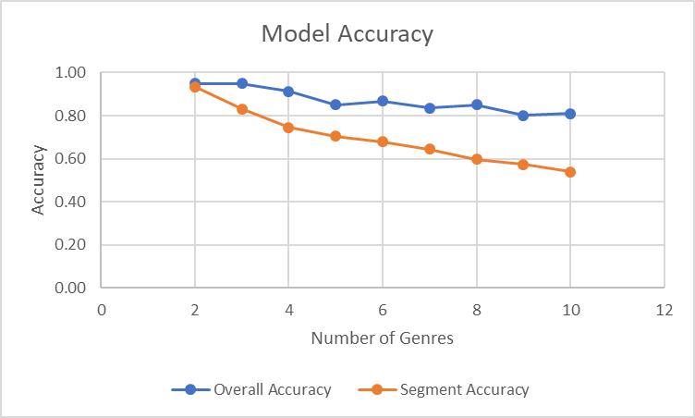
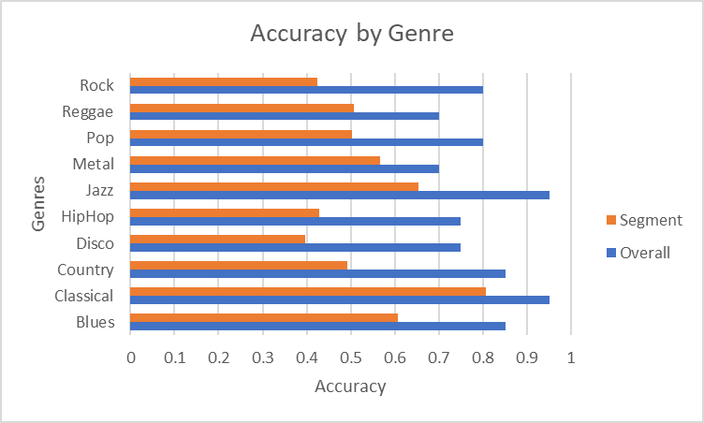
Segmentation Model: Accuracy

Slide 37
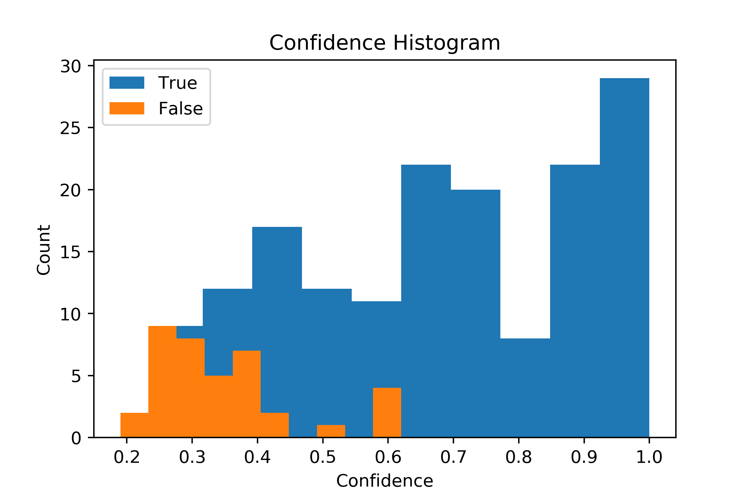
Segmentation Model: Confidence

Slide 38
Segmentation Model: Timing
Dataset Size
Timing
Training Raw: 800x661500
Testing Raw: 200x661500
Training MFCC: 800x150x128x9
Testing MFCC: 200x150x128x9
Pre-Processing: 547s
Training: 666s
Testing: 109s
Total: 1322s

Slide 39
Segmentation Model: Timing
Dataset Size
Timing
Training Raw: 529.2 million
Testing Raw: 132.3 million
Training MFCC: 138.2 million
Testing MFCC: 34.6 million
Pre-Processing: 08:51
Training: 11:06
Testing: 01:48
Total: 21:45

Slide 40
Segmentation Model: Examples
Input: Stayin Alive by Bee Gees - Disco
Predicted genre: disco
Confidence: 0.65
0.65 confidence for disco
0.11 confidence for rock
0.08 confidence for reggae
0.06 confidence for hiphop
0.04 confidence for jazz
0.02 confidence for blues
0.02 confidence for country
0.01 confidence for metal
0.01 confidence for pop
0.0 confidence for classical

Slide 41
Segmentation Model: Examples
Input: Contrapunctus IX by Bach, Classical
Predicted genre: classical
Confidence: 0.92
0.92 confidence for classical
0.04 confidence for jazz
0.03 confidence for country
0.0 confidence for blues
0.0 confidence for disco
0.0 confidence for hiphop
0.0 confidence for metal
0.0 confidence for pop
0.0 confidence for reggae
0.0 confidence for rock

Slide 42
Segmentation Model: Examples
Input: Moments Notice by Chris Potter - Jazz
Predicted genre: jazz
Confidence: 0.73
0.73 confidence for jazz
0.07 confidence for disco
0.06 confidence for classical
0.04 confidence for rock
0.03 confidence for country
0.02 confidence for blues
0.02 confidence for hiphop
0.02 confidence for pop
0.01 confidence for reggae
0.0 confidence for metal

Slide 43
Segmentation Model: Examples
Input: Exodus by Bob Marley - Reggae
Predicted genre: reggae
Confidence: 0.5
0.5 confidence for reggae
0.21 confidence for disco
0.09 confidence for hiphop
0.07 confidence for rock
0.04 confidence for country
0.03 confidence for blues
0.03 confidence for pop
0.01 confidence for classical
0.01 confidence for jazz
0.01 confidence for metal

Slide 44
Segmentation Model: Examples
Input: Panic Attack by Dream Theater - Metal
Predicted genre: metal
Confidence: 0.8
0.8 confidence for metal
0.06 confidence for pop
0.06 confidence for rock
0.05 confidence for blues
0.01 confidence for disco
0.01 confidence for hiphop
0.01 confidence for jazz
0.0 confidence for classical
0.0 confidence for country
0.0 confidence for reggae

Slide 45
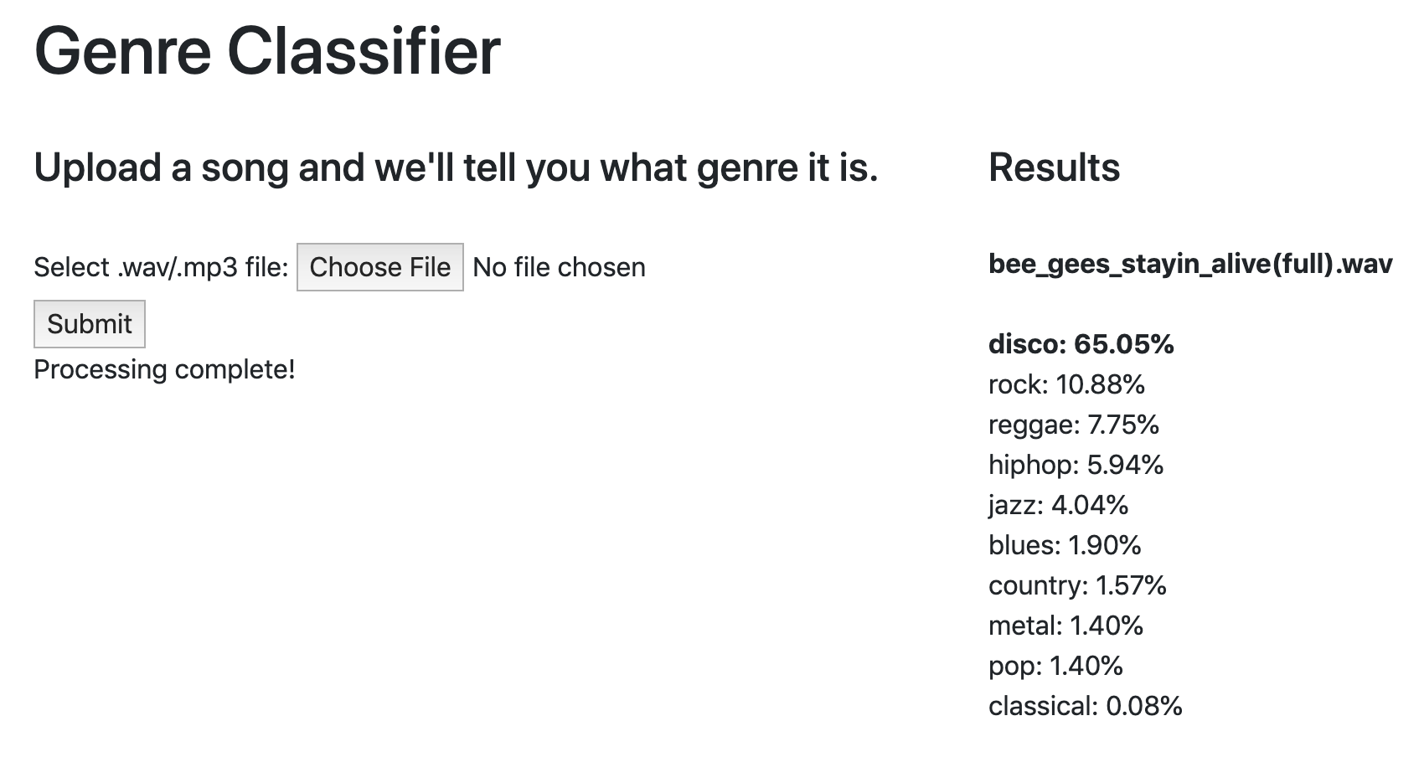
Segmentation Model: Web API

Slide 46
Future Work

Slide 47
Future Work
Metadata Model
Balanced Dataset
Use other Metadata (Album Name, Loudness, Key)
CNN Spectrogram Model
Different Transformations on the Audio
More Training Data
Neural Net MFCC Model
Weighted voting based on surrounding segments’ results
Web-App
Backend to retrieve past predictions
User functionality
Deploying to live servers

Slide 48
References
Thierry Bertin-Mahieux, Daniel P.W. Ellis, Brian Whitman, and Paul Lamere. The Million Song Dataset. In Proceedings of the 12th International Society for Music Information Retrieval Conference (ISMIR 2011), 2011.
Martín Abadi, Ashish Agarwal, Paul Barham, Eugene Brevdo, Zhifeng Chen, Craig Citro, Greg S. Corrado, Andy Davis, Jeffrey Dean, Matthieu Devin, Sanjay Ghemawat, Ian Goodfellow, Andrew Harp, Geoffrey Irving, Michael Isard, Rafal Jozefowicz, Yangqing Jia, Lukasz Kaiser, Manjunath Kudlur, Josh Levenberg, Dan Mané, Mike Schuster, Rajat Monga, Sherry Moore, Derek Murray, Chris Olah, Jonathon Shlens, Benoit Steiner, Ilya Sutskever, Kunal Talwar, Paul Tucker, Vincent Vanhoucke, Vijay Vasudevan, Fernanda Viégas, Oriol Vinyals, Pete Warden, Martin Wattenberg, Martin Wicke, Yuan Yu, and Xiaoqiang Zheng. TensorFlow: Large-scale machine learning on heterogeneous systems, 2015. Software available from tensorflow.org.
George Tzanetakis, GTZAN Genre Collection. [Online]. Available: http://marsyas.info/downloads/datasets.html
B. McFee et al., “librosa/librosa: 0.7.1,” Nov. 2019. [Online]. Available: https://zenodo.org/record/3478579#.Xd0xfehKiUk

